Slide 1
CSCE - 3600 Principles of systems programming
Term Project

Slide 2
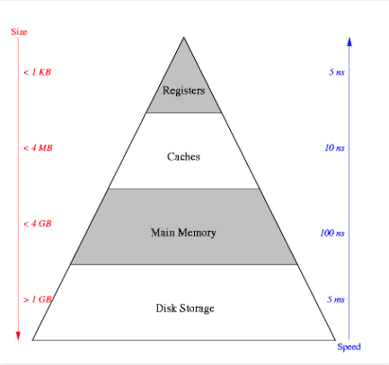
Memory Hierarchy
Shamelessly retrieve from http://1appu.blogspot.com

Slide 3
What is cache
Main Memory
CPU
Cache

Slide 4
How cache works
Different designs of cache
Split caches.
Unified caches.
Physical address caches.
Virtual address caches.
Implementations of caches
Direct mapping
Fully associative
Set-associative
Sector mapping.

Slide 5
Direct mapped cache
Main Memory
Cache Lines
B0
B1
B2
Tag
CL1
B3
B4
B5
Tag
CL2
B6
B7
B8
Tag
CL3
B9
B10
B11
B12
Tag
CL4
B13
B14
B15

Slide 6
Fully Associative
Main Memory
Cache Lines
B0
B1
B2
Tag
CL1
B3
B4
B5
Tag
CL2
B6
B7
B8
Tag
CL3
B9
B10
B11
B12
Tag
CL4
B13
B14
B15

Slide 7
Term project description
Cache Simulator
3 Modules
Parser
Simulation Core
Reporter
I’ll provide
C++ model (is not required to follow it)
Small Trace – 100 lines
Big Trace – 1 000 000 lines

Slide 8
Term Project Description
Example of input trace:
1 10013c68
1 43d41c
0 43d420
1 43d9d4
1 43d9d8
0 43d9dc
1 43d474
0 10016b4c
0 43d478
1 41e82c
0 100169ac
0 41e830
Where: 0 is a write in cache and 1 is a read from cache
The second column is a 32-bit memory address

Slide 9
PART 1 DUE 03.13.2015
Goals for Part 1:
Parsing Trace
Parsing the input parameters
Report the input
You must submit:
Source code (zip)
User document
Maintenance document

Slide 10
Part 1 Due 03.13.2015
Example of part 1:
Input:
$>./program –sizeL1 500 –sizeL2 1000 –type direct < trace.trace
Output:
Input Parameters read:
SizeL1 500
SizeL2 1000
Type Direct
Memory references from read from file
100 Total
XX Reads
XX Write

Slide 11
Questions?

